Slide 1
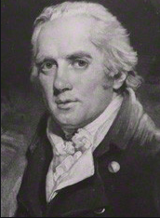
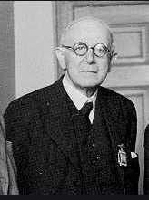
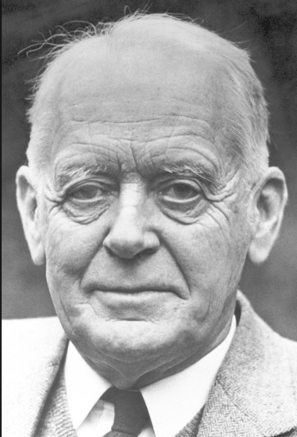
Thornton’s and Hawtrey’s Influences on Hicks’s Theory of Short-Term Rates of Interest
The Journal of the History of Economic Thought (JHET), Cambridge University Press, Volume 41, Issue 3, September 2019, pp.393-410
Author: Lucy Brillant¹
Abstract
Discussion
John Richard Hicks proposed an endogenous theory of money from the 1960s until his final book A Market Theory of Money (1989). He developed a theory of credit, and a theory of short-term rates of interest that had been neglected in his earlier writings such as “Mr Keynes and the Classics” (1937). In that early article, Hicks concentrated on the market for cash balances and the motives for the demand for money, while leaving aside the money market and the clearing function of banks. In the 1960s, Hicks was largely inspired by Henry Thornton (1802) and Ralph George Hawtrey (1913, 1919). The originality of my paper is to analyze the elements described above, which will help to interpret the short-term rates as the price of liquidity in Hick’s thought. This will enable us to understand why Hicks was so opposed to restrictive monetary policies in the 1960s–1970s in Britain, and so opposed to Friedman’s monetarism.
In “Mr Keynes and the Classics” (1937), the young John Richard Hicks set aside an analysis of money in which money was created to cancel debts, and in which banks played a crucial role; he concentrated instead on the market for cash balances and the motives for the demand for money. In the 1930s, Hicks focused on long-term rates of interest (notably in his famous Value and Capital, 1939). This present paper focuses on the “older” Hicks who, between Critical Essays in Monetary Theory (1967) and his final book, A Market Theory of Money (1989), 2 analyzed the formation of short-term rates of interest. Axel Leijonhufvud (1981, p. 40 and 1984, p. 26), Giuseppe Fontana (2009, p. 73), Jean François Goux (1990), David Laidler (in The Legacy of John Hicks, Harald Hagemann, 1995) and Perry Mehrling (2017) have all underlined Hicks’s interest in credit and banking theory since the 1960s. Jérôme De Boyer and Ricardo Solis (2003, p. 11) and Sylvie Diatkine (2003) wrote that Hicks’s final book analyzed the function of the lender of last resort, and that it should be likened to Hawtrey’s and Thornton’s contributions to monetary theory.
Considering this literature, this paper links Hicks’s theory of money and credit to both Thornton’s and Hawtrey’s thinking. This filiation enables us to give some coherence to Hicks’s theory of interest rates, from Value and Capital (1939) to A Market Theory of Money (1989).
Main objective and key idea
In order to appraise the evolution of the thought of Hicks about the short-term rate of interest, my paper is composed of seven key ideas. The first section analyses the functioning of a credit economy which is present in the thinking of Thornton, Hawtrey and Hicks. In the second section, I focus on the nature of money. Money and credit are two separate concepts. Hicks’s “two spheres of circulation” (1989, pp. 49-51) enable us to grasp this difference. The third section concerns the role of the banking system. The fourth section tries to impart some coherence to Hicks’s theory of interest rates, from Value and Capital (1939), with its focus on long-term interest rates, to his final book A Market Theory of Money (1989), where a complete theory of the short-term interest rates appears. The fifth section deals with the necessity to manage credit instability, and the sixth section presents Thornton’s and Hicks’s skeptical views of monetary rules. Lastly, the seventh section is about Hicks’s fight against overly restrictive monetary policies to combat the high inflation rate in Britain in the 1960s–1970s.
Conclusions
I explain in this paper that Hicks’s credit theory is the result of several influences. His description of the money market, where the central bank fixes the price of bills against cash, links him to the tradition of Thornton and Hawtrey. This contradicts some literature linking Hicks to the neoclassical school of thought. This filiation to earlier authors provides an interpretation of Hicks’s theory of short-term rates, his vision of the role of the central bank and his rejection of excessively severe disinflationary policies in the 1960s. Hicks’s interest for Thornton can be understood as a way to counteract Monetarism, because he did not establish a systematic relation between the quantity of money and the level of prices (Skaggs, 2012, p. 457). Hicks was worried that overly severe monetary restrictions would disrupt the working of the market for bills. Hawtrey, but also a monetarist like Friedman, was also in favor of those policies, writing that “inflation is a monetary malady” (Letter of 12 March 1948, “Hawtrey’s Paper”, Churchill College). Hicks considered, however, that post-war inflation was mainly the result of non-monetary forces. Unfortunately, other than blaming monetarists prescriptions, Hicks failed to come up with alternative policies, and he failed to propose alternative policies to fight high inflation.
Figure 1. Henry Thornton
(1760-1815)
Figure 2. Ralph George Hawtrey
(1879-1975)
Figure 3. John Richard Hicks
(1904-1989)
References
de Boyer des Roches, Jérôme and Solis, Ricardo. 2003. Les approches classiques du prêteur en dernier ressort : de Baring à Hawtrey. Cahiers d’Economie Politique, 45 (2): 79-100.
Diatkine, Sylvie. 2013. Monetary policy on interest rates: A retrospective analysis. European Journal of the History of Economic Thought, 20 (5): 715-740.
Friedman, Milton. 1968. The Role of Monetary Policy. The American Economic Review, 58 (1): 1-17.
Hawtrey, Ralph George. [1919] 1928. Currency and Credit. Longmans, Green and Co, Third Edition.
Hicks, John Richard. 1969. Automatists, Hawtreyans, and Keynesians. Journal of Money, Credit and Banking, 1 (3): 307-317.
Hicks, John Richard. 1974. The Crisis in Keynesian Economics. Oxford University Press.
Hicks, John Richard. 1975. What Is Wrong with Monetarism. Lloyds Bank Review, No. 118 in Harry Johnson in The Keynesian Revolution and the Monetarist.
Laidler, David. 2002. Two views of the lender of last resort: Thornton and Bagehot. Cahiers d’Economie Politique, 45 (2): 61-78.
Leijonhufvud Axel. 1981. “Monetary Theory in Hicksian Perspective.” In Information and Coordination: Essays in Macroeconomic Theory, Oxford University Press.
Thornton, Henry. [1802] 1939. An Enquiry into the Nature and Effects of the Paper Credit of Great Britain. Introduction of F.A. Hayek. George Allen and Unwin, London.
Contact
¹Lucy Brillant
Laboratoire d’Économie de Dijon
Email: lucy.brilliant@u-Bourgogne.fr
Website: ledi.u-bourgogne.fr
Lucy Brillant gratefully acknowledges financial support
from the research center PHARE, University Paris1 Pantheon-Sorbonne.
This paper received a Price from the History of Economics Society, (Lansing, United States) in 2015.

