Slide 1
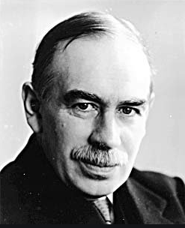
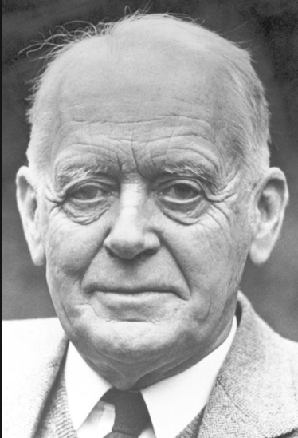
A Reconsideration of the role of forward-market arbitrage in Keynes’s and Hicks’s theories of the term structure of interest rates
The European Journal of the History of Economic Thought (EJHET), Volume 21, Issue 6, December 2014, pp1085-1101
Author: Lucy Brillant¹
Abstract
Results
This paper develops the relationship between Hicks’s and Keynes’s writings on the theory of the term structure of interest rates and shows in detail how Hicks built on and extended Keynes’s account. According to this theory, the level of the long-term interest rate is determined by expectations of future short-term rates. Keynes’s thinking contained several notions – such as the preferred habitat of lenders, the theory of forward markets, and risk-premiums – which Hicks used to give a more complete theory of the term structure of interest rates. Besides implementing these notions in his own theory, Hicks introduced the concepts of the preferred habitat of borrowers, the liquidity risk premium, and arbitrageurs who can take advantage of spreads between spot and forward rates and eliminate risk premiums.
A reconstruction from its origins of the theory of forward market arbitrage in the original version in Keynes’s and Hicks’s books.
An analysis of the working of arbitrage and the transmission of monetary policy throughout the different maturity stages of riskless assets.
The arbitrages are the main determinant of the term structure of interest rates.
Discussion
Keynes is often considered to be the father of the liquidity trap, in which the action of the monetary policy of the central bank is weak. This paper shows that in the Treatise on Money (1930) Keynes developed a first version of the theory of the term structure of interest rates. His neglect of monetary policies is due to the particular context of the 1930s when long-term interest rates did not respond well to monetary policy.
Hicks is known for developing a “real” theory of the economic cycle, in which money makes little impact on the level of production. In his early writings however, we clearly see that he supports Keynes’s view of money, and that the central bank exerts a significant impact on the level of production.
Main objective and key idea
A first objective of this paper studies the functioning of the term structure of interest rates in a context of certainty. In such a context, thanks to arbitrages, the long-term rate of interest reflects the average of current and expected short-term rates of interest. Because the short-term rate of interest is influenced by the central bank, it is a monetary phenomenon in Keynes’s thought.
A second objective considers risk in a context of uncertainty and the original modelling of this risk in the thinking of Keynes and Hicks.
Conclusions
Keynes and Hicks stressed in different manners a link between the short-term rate and the long-term rate of interest. Arbitrages are crucial in their theories. These agents can take advantage of spreads between expected short/spot rates and forward rates. Indeed, because of the “constitutional weakness” of markets associated with the preferred habitat of lenders and borrowers, arbitrageurs can make profits when expected short/spot rates are lower than forward rates. Through these arbitrages, the level of the risk-premium can be reduced. As a consequence, the average of current short rate and forward rates diminishes. Therefore, the long-term rate of interest falls.
Figure 1. John Maynard Keynes
(1883-1946).
Figure 2. John Richard Hicks
(1904-1989).
Materials
References
1. Greenwood, Robin and Dimitri Vayanos, 2010. Price pressure in the government bond
market. American Economic Review, 100, 585-90.
2. Hicks, John R., 1939a. Value and Capital. An Inquiry into Some Fundamental Principles of Economic Theory. Second Edition (1946) reprinted in 1965. Oxford: Clarendon Press.
3. Keynes, John Maynard, 1930. A Treatise on Money. Volume 2. (First edition) London:
Macmillan.
4. Keynes, John Maynard, 1936. The General Theory of Employment, Interest and Money. London: Macmillan (Edited in 1949).
5. Masera, Rainer, 1972. The Term Structure of Interest Rates. An Expectations Model Tested on Post-War Italian Data. Oxford: Clarendon Press.
6. Meiselman, David, 1962. The Term Structure of Interest Rates. Englewood Cliffs: Prentice
Hall.
7. Modigliani, Franco and Richard Sutch, 1966. Innovations in interest rate policy. The
American Economic Review, 56, 178-97.
8. Simmons, Edward Christian, 1933. Mr. Keynes’ control scheme. American Economic Association, 23(2),264-73.
9. Vayanos, Dimitri and Jean-Luc Vila, 2009. A preferred-habitat model of the term structure of interest rates. Working Paper 15487. Available from: http://www.nber.org/papers/ w15487.
The materials used are original texts by John Maynard Keynes and John Richard Hicks.
Contact
¹Lucy Brillant
Laboratoire d’Économie de Dijon
Email: lucy.brilliant@u-Bourgogne.fr
Website: ledi.u-bourgogne.fr
Lucy Brillant gratefully acknowledges financial support
from the research center PHARE, University Paris1 Pantheon-Sorbonne,
from the Gilles Dostaler Award 2016, European Society for the History of Economic Thought (ESHET),
and from the Institute for New Economic Thinking (INET) 2013

