Slide 1
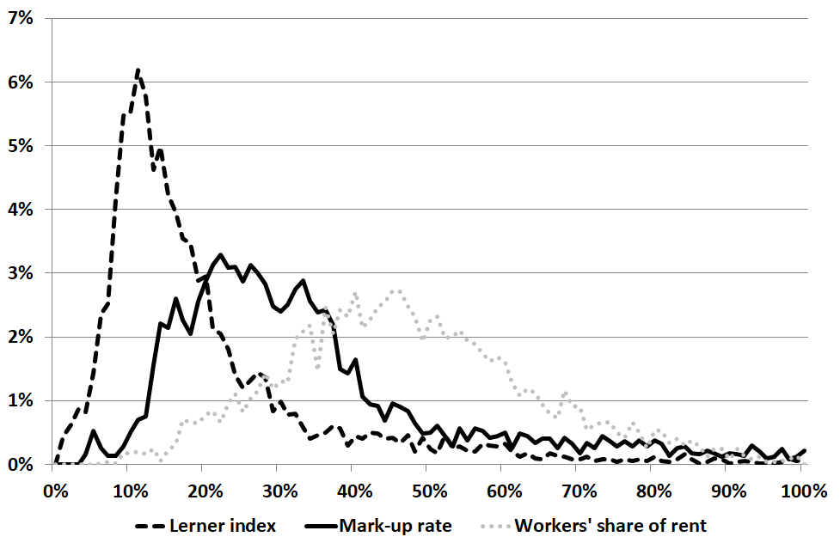
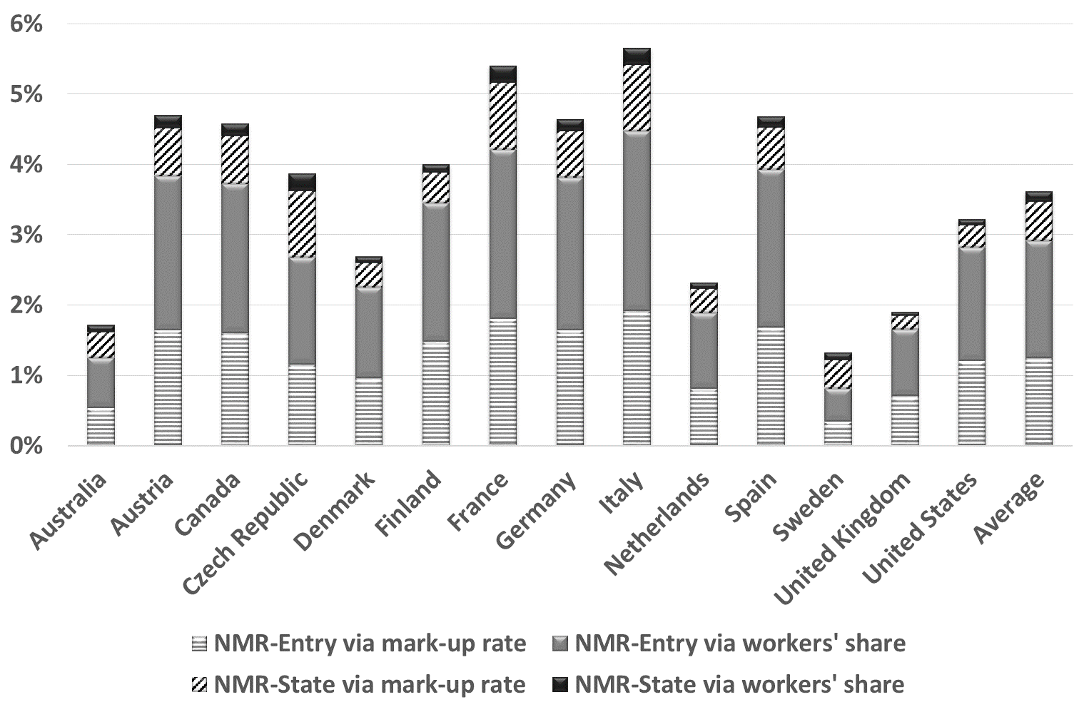
Rent Creation and Rent Sharing:
New Measures and Impacts on Productivity
Gilbert CETTE^{1,2}; Jimmy LOPEZ^{1,3}; Jacques MAIRESSE^{1,4,5,6}
¹Banque de France, ²AMSE, ³UBFC, ⁴CREST-ENSAE, ⁵UNU-MERIT, ⁶NBER
Economic Inquiry, 57(4), 2019
Introduction
Materials
An extensive empirical literature has investigated the impact of competition on productivity using OECD Non-Manufacturing Regulation (NMR) indicators
(e.g. Conway et al., 2006; Barone and Cingano, 2011)
Some papers have also used OECD Employment Protection Legislation (EPL) indicators to gauge the impact on productivity of labour market inflexibility
(e.g. Bassanini, Nunziata and Venn, 2009)
In Blanchard and Giavazzi’s (2003) theoretical model, the creation of rents results from product market regulations, while workers’ rent-sharing is influenced by labour market regulations
Based on this theoretical approach, we investigate the channels between NMR, EPL and productivity
We use cross-country-industry panel data covering 14 OECD countries and 19 industries over the period 1985–2005
The OECD NMR and EPL indicators:
Are based on information on laws, rules and market settings
NMR indicators measure the extent to which competition and firm choices are restricted for five industries: energy, transport, communication, retail services and professional services
EPL indicators measure the procedures and costs involved in dismissing individual workers with regular contracts and regulations on temporary contracts
2. Impact of regulations on rent
1. New measures of rent creation & sharing
We regress our new measures of rent creation and sharing on OECD NMR and EPL indicators, using the fixed effect estimator
(Table 1 shows the estimation results)
We confirm Blanchard and Giavazzi’s (2003) theoretical model:
NMR influences rent creation positively
EPL has no impact on rent and boosts hourly wage rates
But with interesting differences:
NMR also influences the workers’ share of rent positively
EPL has a negative impact on the intensity of use of labour
While standard measures of mark-up, such as the Lerner index, assume perfect labour markets, our new measures relax this assumption by considering that workers may appropriate part of the rent created in their industry through their wages.
In our sample, on average, rents are shared equally between workers and firms, but with marked variations between observations (see Graph 1):
The Lerner index provides a very noisy measure of total mark- up and so of lack of competition.
 | Mark-up rate | Workers’ share of rent | Workers’ rent per hour | Intensity of use of labour
 | (1) | (2)=(3)+(4)-(1) | (3) | (4)
NMR - Entry | 0.0516*** | 0.0644*** | 0.0510*** | 0.0641***
NMR - State | 0.0229** | 0.00546 | -0.00696 | 0.0350***
EPL - Impact | 0.0124 | -0.161 | 0.375*** | -0.487***
‘NMR-Entry’: barriers to entry; ‘NMR-State’: State control; ‘EPL-impact’: EPL x the intensity of use of labour
*** p<0.01, ** p<0.05, * p<0.1
Table 1. Impact of regulation indicators on rent creation and sharing
Graph 1. Mark-up rate and rent sharing, Density
3. Impact on productivity
We investigate the Total Factor Productivity (TFP) impact of rent creation and rent sharing – and of regulations changing them – by performing instrumental variable regressions
We use the OECD regulation indicators as relevant instruments
We find that both rent creation and workers’ share of rent have a detrimental impact on TFP
Using our estimation results, we calibrate an illustrative out-of-sample policy simulation of TFP gains from changes towards greater competition (i.e. the adoption of the lightest NMR)
This simulation confirms that the gains expected from implementing ambitious NMR reforms could be significant in many countries (see Graph 2)
Graph 2. TFP gains from adopting the lightest NMR
Conclusions
Firms’ rent differs markedly from total rent creation
The positive impact of EPL on wages is offset by a negative impact on the intensity of use of labour
NMR (mostly barriers to entry) negatively influences TFP through both rent creation and rent sharing
Contact
References
LOPEZ Jimmy
Laboratoire d’Économie de Dijon
Email: jimmy.lopez@u-Bourgogne.fr
Website: ledi.u-bourgogne.fr
Phone: +33 (0)3 80 39 54 42
Barone, G. and F. Cingano (2011): Service regulation and growth: evidence from OECD countries, The Economic Journal, 121(555), 931-957.
Bassanini, A., L. Nunziata and D. Venn (2009): Job protection legislation and productivity growth in OECD countries, Economic Policy, 24(58), 349-402.
Blanchard, O. and F. Giavazzi (2003): Macroeconomic effects of regulation and deregulation in goods and labor markets, The Quarterly Journal of Economics, 118(3), 879-907.
Conway, P., D. de Rosa, G. Nicoletti and F. Steiner (2006): Product market regulation and productivity convergence, OECD Economic Studies, 43, 39-76.

