Slide 1
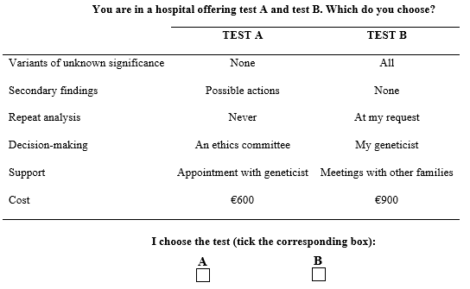
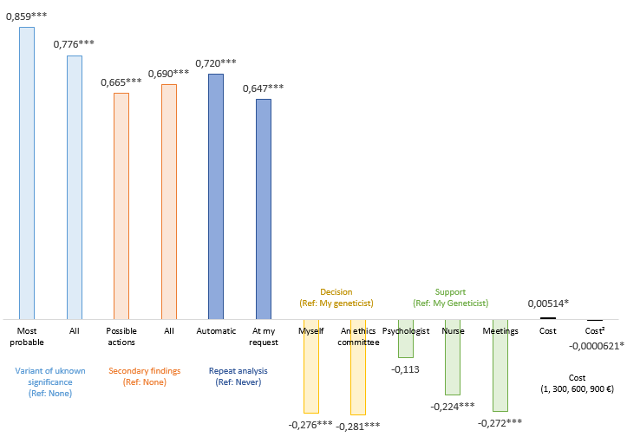
Preference heterogeneity with respect to whole genome sequencing.
A discrete choice experiment among parents of children
with rare genetic diseases
Christine Peyron, PhD¹; Aurore Pélissier, PhD¹; Sophie Béjean, PhD¹
¹Université de Bourgogne Franche-Comté
Social Science & Medicine 214 (2018) 125-132
Abstract
Figure 1. Example of a choice set.
The information to which whole genome sequencing (WGS) provides access raises questions about its disclosure to patients. The literature focused on the nature of findings shows patients share the same expectations while evoking possible heterogeneity. Our objective is to test this hypothesis of preference heterogeneity with respect to the disclosure of results from WGS by means of a discrete choice experiment (DCE).
Our DCE includes six attributes for studying preferences with respect to (1) variants of unknown significance (genetic mutations whose connection with the pathology for which the test was prescribed stems from presumptions based on geneticists’ experience and knowledge and not on fully confirmed scientific data) and (2) secondary findings (genetic mutations that cause or will cause other diseases than the one for which the test was prescribed), and more innovatively with respect to (3) repeat analysis of the tests, (4) the decision-making process, (5) patient support and (6) the cost of testing. The survey was conducted at two genetic centres in France from February to December 2015 and included 528 parents of patients with development disorders with no aetiological diagnosis. By using a latent class model (LCM), it was possible to identify two preference profiles with parents opting for either a prospective (75% of sample) or a targeted (25%) diagnostic approach. The former valued the exhaustive and diverse genetic information the test can provide, even when the information is uncertain or not directly related to their child’s illness; the latter valued only the least uncertain information relating to their child’s illness. Understanding patients’ preference patterns can help professionals to better accommodate and support patients and enables policy-makers to measure the diversity of expectations in the face of current developments in genomic medicine.
Results
Respondent characteristics: 513 respondents (48% in Lyon, 52% in Dijon). They are mostly mothers (65%) whose mean age is 37 years. The age of the children concerned ranged from the foetus up to 33 years old, with a median value of five years old. One fifth of respondents said they had plans for having a child or that a pregnancy was underway. Most families were waiting for a diagnosis. 73% of respondents judged their knowledge of genetics to be poor or very poor. The notions of variant of unknown significance and secondary findings were judged by most to be clear or very clear.
Preference heterogeneity: For estimating choices with LC, we retained a two-class model (based on Corrected AIC, BIC and the rate of correct predictions). Respondents fall unequally into the two classes: 75% in class 1, 25% in class 2. Class 1: respondents have identical preferences to the mean preferences of the entire sample (CL estimation, Graph 1). The only notable difference is that “Cost” and “Cost²” are no longer significant. Class 2: parents have somewhat different preferences from those obtained with the CL. “Secondary Findings” again have the highest relative importance, but the impact is now negative. “Cost” becomes significant but “Repeat analysis” is no longer statistically significant. “Support” and “Decision-making” have the same signs and are significant in both classes, but these attributes are comparatively more important in class 2.
Main objective and key idea
Whole genome sequencing (WGS) could soon become a first-line strategy for diagnostic testing in genetic medicine with the routine use of next-generation sequencing. While improving diagnostic performance is promoting the spread of WGS (Ashley et al., 2010; Retterer et al., 2016; Yang et al., 2014), there are still obstacles. These are broadly related to questions about the use made of the data obtained, their clinical utility and the disclosure of results to patients. Research in recent years has made it possible to better determine patients’ preferences with respect to access to genetic testing and its results. While the preferences revealed are favourable on average, they may conceal disparities. It would seem then that individual preference heterogeneity results from personal positions that cannot be readily associated with a particular context or with objective characteristics. Our article aims to further this hypothesis about preference heterogeneity, by highlighting different structures of preference towards genetic testing that might place the heterogeneity observed in a different light.
In our study, respondents are French parents of children with rare diseases (RDs) with development disorders (DDs) and who could benefit from WGS if it was proposed as a routine diagnosis. Such RDs represent two-thirds of the known genetic diseases and their cause is not known in 1 case in 2. WGS may lead to a significant increase in diagnosed cases from 50% to 80% (Willemsen and Kleefstra, 2014) but it is not yet used in France in routine diagnosis. The preferences we study are therefore parents’ preferences with respect to WGS prior to actual inclusion in a WGS diagnostic protocol and our objective is to examine possible heterogeneity of their preferences.
Graph 1. Conditional logit.
Notes:
***, **, * statistically significant at the 1%, 5% and 10% level respectively
Cost and Cost² are rescaled (basis 90 rather than 900).
Interpretation
General: the coefficients measure the impact on utility of the transition of the attribute from the reference level to the value under consideration. If one level of an attribute is significant it implies that shifting from the reference levels to the attribute levels modifies parents’ well-being.
Examples: for “Variant of unknown significance”, going from no result to the most probable results raises utility more than going to all results. “Repeat analysis” also increases respondents’ utility but slightly less so if it is at the parents’ request than if done automatically.
Discussion
Methods and Materials
Our results show the contribution of the LC to the perception of the diversity of expectations of WGS by objectivizing the existence of different preference models.
Although our results are related in part to the context of the survey, they have implications for health care and for public policy. They draw attention to different attitudes and overall positions with respect to WGS. Regardless of the objective clinical utility of the findings, respecting patient choice may mean allowing a minority of patients not to know any of them, but also agreeing to disclose non-actionable findings for patients with a strong preference for genetic information. In both cases, the professional must evaluate the information to be provided to allow an informed and autonomous decision for each type of patient. The divergence in personal utilities should be integrated to assess the merits of the development of these technologies in terms of collective well-being.
Preference profiles are key elements for informing public debate on our expectations and the desirable conditions of this dissemination. They may also be points of support for designing and then evaluating public policies aimed at collective progress and respectful of individual choices.
For each step in the DCE – choice of attributes and levels, questionnaire design and completion, econometric analysis – we followed the most recent good practice guidelines (Bridges et al., 2011; Hauber et al., 2016; Johnson et al., 2013; Louvière and Lancsar, 2009).
The DCE involved combining the levels of the six attributes into scenarios among which respondents had to pick (attributes and their levels are listed in Graph 1). An orthogonal main effect plan was designed with Ngene software. It yielded 36 choice sets, randomly blocked into six versions. Each choice set contains two unlabelled alternatives “Test A” and “Test B” (Figure 1). We estimated the preferences with two models, a conditional logit and a LCM. For both CL and LC, the coefficients measure the impact on utility of the transition of the attribute from the reference level to the value under consideration.
The survey was conducted from February to December 2015 in the centres for genetics of Lyon and Dijon university teaching hospitals in France. Respondents were parents of patients with RDs with no aetiological diagnosis, who might benefit from WGS if introduced as a routine diagnosis, who had no difficulty in expressing themselves in French, and who were seen in consultation over the inclusion period.
Contact
References
Christine PEYRON
Laboratoire d’Économie de Dijon
Email: Christine.peyron@u-Bourgogne.fr
Website: ledi.u-bourgogne.fr
Peyron et al. gratefully acknowledge financial support from Fondation Maladies Rares (Call for proposals Human and Social Sciences, 2014), Burgundy Regional Council (Plan d’Actions Régional pour l’Innovation) and PO FEDER-FSE Bourgogne 2014/20 programmes.
Ashley, E.A. et al. (2010). Clinical assessment incorporating a personal genome. Lancet, 375(9725), 1525-35.
Bridges, J.F.P. et al. (2011). Conjoint analysis applications in health - a checklist: A report of the ISPOR Good Research Practices for Conjoint Analysis Task Force. Value in Health, 14, 403-13.
Hauber, A.B. et al. (2016). Statistical methods for the analysis of discrete-choice experiments: A report of the ISPOR Conjoint Analysis Good Research Practices Task Force A. Value in Health, 19(4), 300-15.
Johnson, F.R. et al. (2013). Constructing experimental designs for discrete-choice experiments: A report of the ISPOR Conjoint Analysis Experimental Design Good Research Practices Task Force. Value in Health, 2013, 16, 3-13.
Louviere, J.J. and Lancsar, E. (2009). Choice experiments in health: the good, the bad, the ugly and toward a brighter future. Health Econ Policy Law, 4, 527-46.
Retterer, K. et al. (2016). Clinical application of whole-exome sequencing across clinical indications. Genet Med, 18(7), 696-704.
Willemsen, M.H. and Kleefstra, T. (2014). Genetic diagnostics in intellectual disability: What is the benefit? Ned Tijdschr Geneeskd, 158:A8098.
Yang, Y., Muzny, D.M., Xia, F., et al. (2014). Molecular findings among patients referred for clinical whole-exome sequencing. JAMA, 312(18), 1870-9.

